Slide 1
Cornerstone City Church Peninsula Plus Community Hoo Are Ya
3rd December 2023

Slide 2


Slide 3


Slide 4


Slide 5
Joy To The World
CCLI Song # 7100235
George Frideric Handel | Isaac Watts | Joth Hunt
© 2017 Planetshakers Ministries Int. Inc.
For use solely with the SongSelect® Terms of Use. All rights reserved. www.ccli.com
CCLI License # 33265

Slide 6
1/3
Joy to the world the Lord has come
Let earth receive her King
Let ev'ry heart prepare Him room
And heaven and nature sing
And heaven and nature sing
And heaven heaven and nature sing

Slide 7
2/3
Joy to the world the Saviour reigns
Let men their songs employ
While fields and floods rocks hills and plains
Repeat the sounding joy
Repeat the sounding joy
Repeat repeat the sounding joy

Slide 8
3/3
He rules the world with truth and grace
And makes the nations prove
The glories of His righteousness
And wonders of His love
And wonders of His love
And wonders and wonders of His love

Slide 9
Glorious Day
CCLI Song # 7081388
Jason Ingram | Jonathan Smith | Kristian Stanfill | Sean Curran
© 2017 KPS 1.0 (Admin. by Capitol CMG Publishing)
sixsteps Music (Admin. by Capitol CMG Publishing)
sixsteps Songs (Admin. by Capitol CMG Publishing)
Sounds Of Jericho (Admin. by Capitol CMG Publishing)
Worship Together Music (Admin. by Capitol CMG Publishing)
worshiptogether.com songs (Admin. by Capitol CMG Publishing)
Fellow Ships Music (Admin. by Essential Music Publishing LLC)
Hickory Bill Doc (Admin. by Essential Music Publishing LLC)
So Essential Tunes (Admin. by Essential Music Publishing LLC)
For use solely with the SongSelect® Terms of Use. All rights reserved. www.ccli.com
CCLI Licence No. 33265

Slide 10
1/6
I was buried beneath my shame
Who could carry that kind of weight
It was my tomb 'til I met You

Slide 11
2/6
I was breathing but not alive
All my failures I tried to hide
It was my tomb 'til I met You

Slide 12
3/6
('Cause when) You called my name (and)
I ran out of that grave
Out of the darkness into Your glorious day
You called my name (and) I ran out of that grave
Out of the darkness into Your glorious day

Slide 13
4/6
Now Your mercy has saved my soul
Now Your freedom is all that I know
The old made new Jesus when I met You

Slide 14
5/6
I needed rescue my sin was heavy
But chains break at the weight of Your glory
I needed shelter I was an orphan
Now You call me a citizen of Heaven
When I was broken You were my healing
Now Your love is the air that I'm breathing
I have a future my eyes are open

Slide 15
6/6
('Cause when) You called my name (and)
I ran out of that grave
Out of the darkness into Your glorious day
You called my name (and)
I ran out of that grave
Out of the darkness into Your glorious day

Slide 17


Slide 18
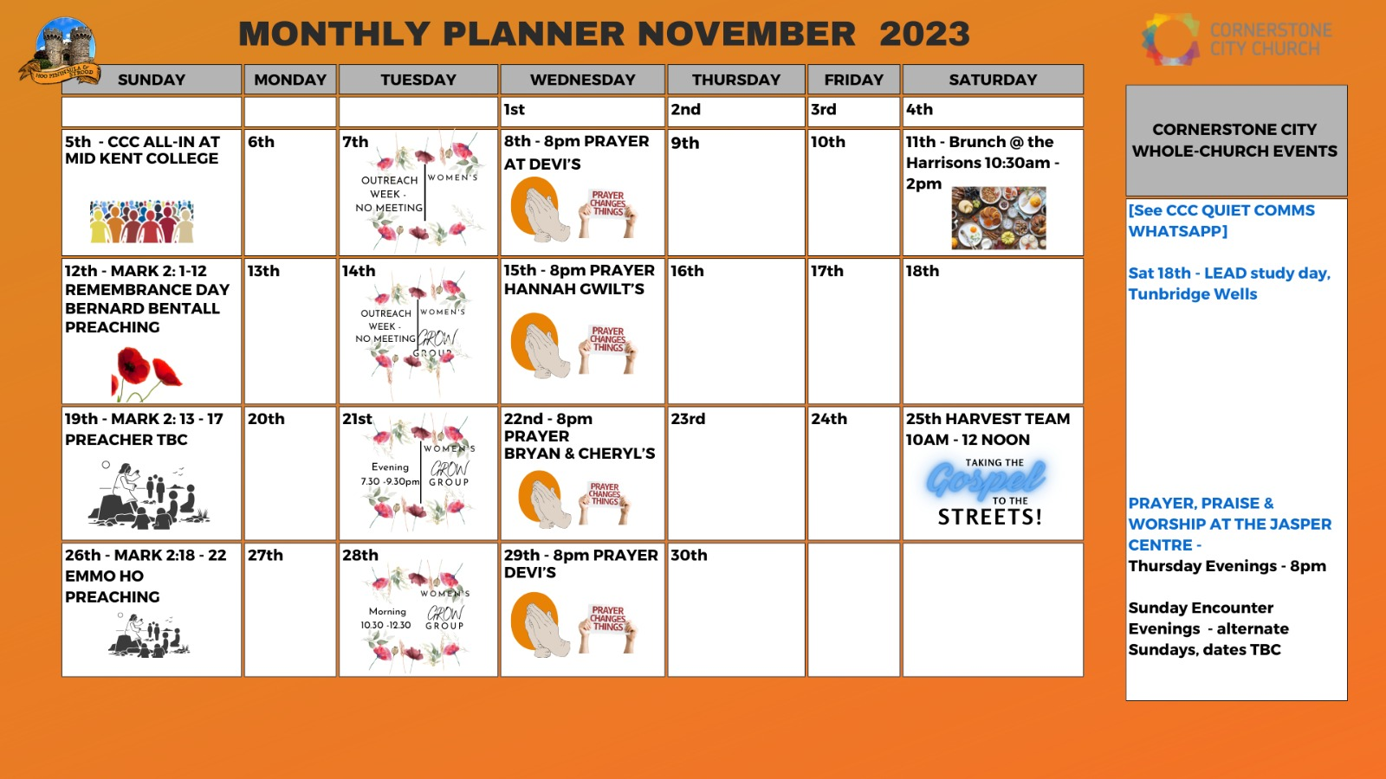

Slide 22
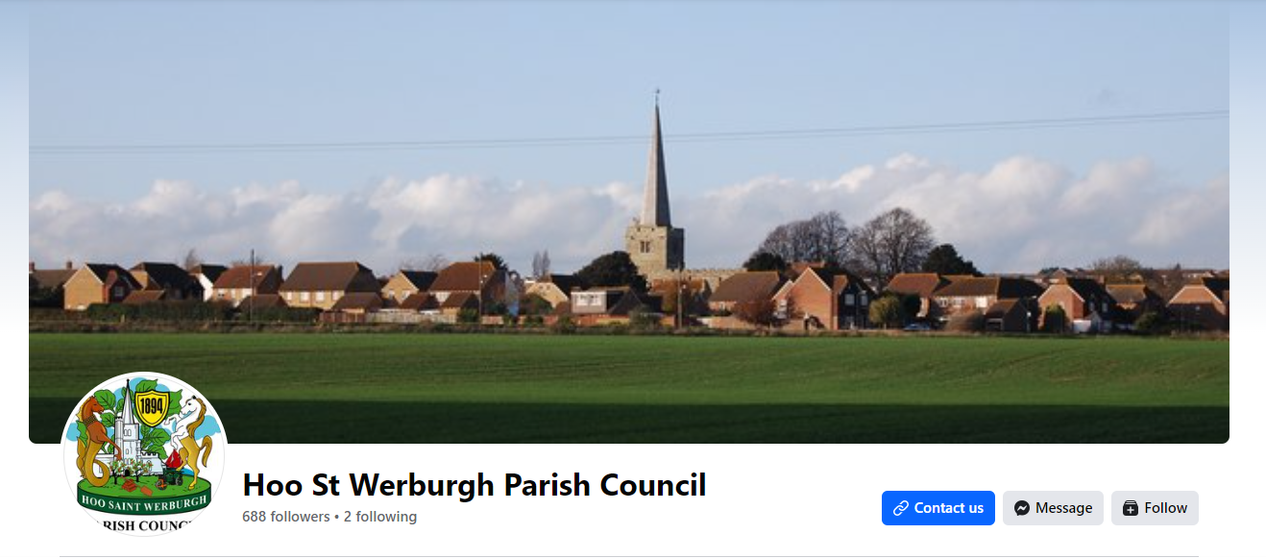
Christmas Celebrationson 8th December in Hoo Square at 6pm
Practice on Monday 4th December at Dele & Florence house. Contact Dele/Florence if you are interested and want to sing in our choir

Slide 23


Slide 24


Slide 25
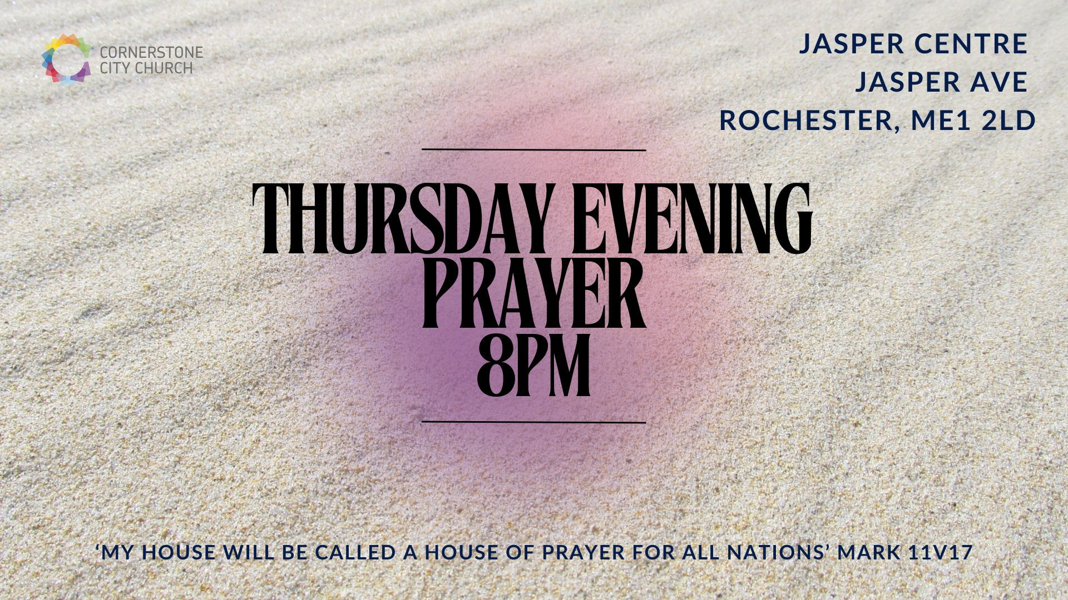

Slide 26


Slide 27


Slide 28


Slide 29


Slide 30
2 Corinthians 14 May the grace of the Lord Jesus Christ, and the love of God, and the fellowship of the Holy Spirit be with you all

